Slide 1
What is Netizen ?
A netizen is a person who actively participates in online communities or uses the internet regularly, often engaging in activities like social media, forums, or other digital platforms. The term combines "internet" and "citizen," implying a sense of belonging or responsibility within the online world.

Slide 2
Malware and its existence
Malware, short for malicious software, is any program or code designed to harm, disrupt, or gain unauthorized access to computer systems, networks, or data. It exists to exploit vulnerabilities for purposes like stealing sensitive information, causing damage, or extorting money. Malware has been a persistent threat since the early days of computing, evolving with technology and driven by motives like financial gain, espionage (जासूसी), or sabotage(तोड़-फोड़).

Slide 3
Types of Malware
Viruses: Self-replicating programs that attach to legitimate files, spreading when executed. They can corrupt or delete data.
Worms: Standalone malware that spreads across networks without needing a host file, often exploiting security flaws.
Trojans: Disguised as legitimate software, they trick users into installing them, enabling backdoors or data theft.
Ransomware: Locks or encrypts files, demanding payment for access. Recent examples include attacks on hospitals and businesses.

Slide 4
5. Spyware: Secretly monitors user activity, collecting data like passwords or browsing habits.
6.Adware: Displays unwanted ads, often bundled with free software, and may track user behavior.
7.Botnets: Networks of infected devices controlled remotely, used for DDoS attacks or crypto mining.
8.Rootkits: Hide deep in systems to maintain persistent access, often evading detection.
9.Keyloggers: Record keystrokes to capture sensitive information like login credentials.

Slide 5
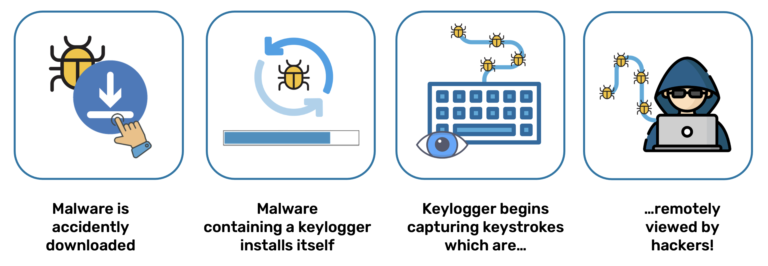
keyboard Logger
A keylogger (keyboard logger) is a type of software or hardware that records every keystroke made on a computer or device, often used to capture sensitive information like passwords, credit card numbers, or other personal data. Keyloggers can be used for legitimate purposes (e.g., monitoring employee activity or parental control) or maliciously (e.g., stealing credentials).

Slide 6
Types of Keyloggers
Software Keyloggers:
Run in the background of a computer or device.
Can be installed via malware, phishing, or social engineering.
Examples: Spyrix, Actual Keylogger, Revealer Keylogger.
Hardware Keyloggers:
Physical devices plugged into a computer, often between the keyboard and the system.
Examples: USB keyloggers or PS/2 keyloggers.
3.Kernel-Based Keyloggers:
Operate at the operating system’s kernel level, making them harder to detect and remove.
4.Hypervisor-Based Keyloggers:
Run in a virtualized environment, capturing keystrokes from the host system.
5.Form-Grabbing Keyloggers:
Capture data entered into web forms before it’s sent to the server.

Slide 7
How Keyloggers Work
Software: Intercepts keyboard inputs by hooking into the operating system’s keyboard API or drivers. Logs are stored locally or sent to a remote server.
Hardware: Captures raw keyboard signals and stores them in the device’s memory or transmits them wirelessly.
Logs can include timestamps, application names, and even screenshots in advanced cases

Slide 8
Legitimate Uses
Parental Control: Monitoring children’s online activity.
Employee Monitoring: Ensuring productivity or compliance in workplaces.
Debugging: Capturing input for software testing.
Malicious Uses
Data Theft: Stealing login credentials or sensitive information.
Spying: Monitoring personal communications without consent.

Slide 9
Detection and Prevention
Antivirus Software: Use updated legitimate antivirus programs to detect software keyloggers.
Task Manager/Process Monitoring: Look for suspicious processes.
Physical Checks: Inspect hardware for unfamiliar devices.
Two-Factor Authentication (2FA): Adds a layer of security even if credentials are stolen.
Virtual Keyboards: Use on-screen keyboards for sensitive inputs to bypass some keyloggers.

Slide 10
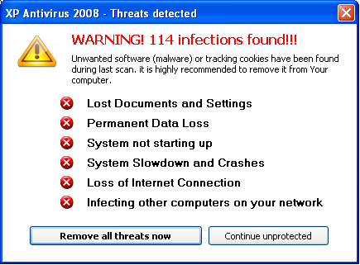
10.Fileless Malware: Operates in memory without leaving traces on the hard drive, making detection harder.
What Type of Malware it can be ?

Slide 11
Why Malware Exists
Malware is created for various reasons, driven by motives like:
Financial Gain: Stealing banking details, extorting via ransomware, or mining cryptocurrency.
Espionage: Governments, corporations, or hackers spy on targets to steal trade secrets or intelligence.
Disruption: Causing chaos, like crashing systems or defacing websites, often for ideological reasons (hacktivism).
Control: Creating botnets for large-scale attacks or remote access to systems.
Personal Vendettas: Targeting individuals or organizations for revenge or harassment.

Slide 12
How Malware Spreads
Email Attachments/Links: Phishing emails with malicious attachments or URLs.
Compromised Websites: Drive-by downloads from infected sites or malvertising.
Software Vulnerabilities: Exploiting unpatched operating systems or applications.
USB Drives/Removable Media: Malware like worms can spread via infected devices.
Social Engineering: Tricking users into downloading fake software or clicking malicious links.
Network Propagation: Worms exploit network weaknesses to spread to connected devices.

Slide 13
Rogue Software and Scareware: Definition and Examples
Rogue Software: Also known as rogue security software or rogueware, this is a type of malicious software that masquerades(deceives users by pretending to be a genuine antivirus or security program) as legitimate security software, such as antivirus or anti-malware programs. It deceives users into believing their computer is infected with viruses or other malware, often using alarming pop-up messages or fake system scans to create a sense of urgency.

Slide 14
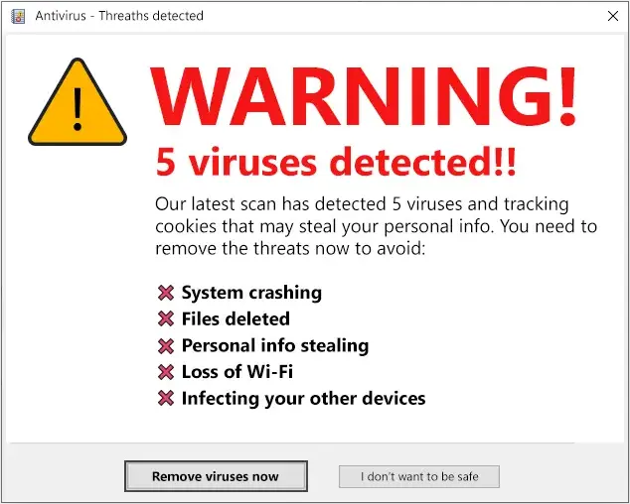
One important characteristic of rogue security software is that it hooks itself deep into the system and cannot be easily removed or uninstalled.

Slide 15
What is Rogue Security Software?
Rogue security software, also known as rogue anti-malware, is a counterfeit software program that appears to be beneficial from a security perspective, but in reality, it’s not. Rogue security software masquerades as genuine security software, generates erroneous or misleading alerts to scare you to partake in fraudulent transactions.
In simple words, the goal of Rogue security software is to deceive you into believing that your computer is infected with some serious threats, and then trick you into installing/purchasing fake security software.

Slide 16
The primary goal is to trick users into purchasing fake security services or downloading additional malware, which can further compromise the system. Rogue software often employs social engineering tactics, exploiting fear to manipulate users, and may install harmful components like spyware or keyloggers. It is considered a form of ransomware or scareware, as it may demand payment for a fake solution that provides no real protection.

Slide 17
Scareware: A broader category of malware that includes rogue security software, scareware uses social engineering to instill fear (gradually introduce or establish a feeling of fear in someone or a group
of people), anxiety, or a perceived threat to manipulate users into taking actions like purchasing useless software or visiting malicious websites.

Slide 18
Scareware typically relies on false warnings, such as claims hundreds of viruses on a user’s device, to push users toward fraudulent transactions or malware installation. Unlike rogue software, which specifically mimics security tools, scareware can also include fake system optimizers, registry cleaners, or even prank software designed to shock users with alarming visuals or messages

Slide 19
Key Differences
Rogue Software is a subset of scareware, specifically pretending to be legitimate or genuine security software (e.g., antivirus programs).
Scareware encompasses a wider range of deceptive tactics, including non-security-related scams like fake system optimizers or alarming pop-ups that don’t necessarily mimic antivirus software. Scareware may also be less harmful in some cases, as it can sometimes be uninstalled more easily than rogue software, which often embeds itself deeply in the system.

Slide 20
Rogue Security Software vs. Scareware
Rogue security software is often confused with scareware. Even though both rely on fear tactics, scareware programs actually does less harm than rogue security programs. Programs like fake registry cleaners, system optimizers mainly fall into the scareware category. These programs are designed to look authentic, but do very little or absolutely nothing of what it claims. Scareware usually uses scary advertising and scary scan results to try to get you to buy something that’s essentially useless. Unlike Rogue security software, scareware programs can be uninstalled from the system easily.

